Slide 1

Is the Grim Reaper Sick in your State?
Joey Bero, Monica Topicz, Daniel Jo, Kolanjiappan Kaliyaperumal
Notes:
Monica

Slide 2

To identify the states with the highest mortality rate due to Influenza and Pneumonia. Upon retrieving this data we’ll look at census information by state to better understand how these two deadly diseases are affected by population and income. Ultimately, which state is the Grim Reaper most prevalent and at which income level.
Tennessee
North Carolina
Hawaii
Kentucky
- Proposal
Influenza/Pneumonia
Notes:
Monica

Slide 3
Questions we want answers to
Which states have the highest rate of death by flu and pneumonia ?
Which flu season had the most deaths?
How did the highest death rate correlate with population size?
Does poverty affect death rates?
Does education level affect death rates?
Does age affect death rates?
Does temperature affect death rates?
Does vaccination affect death rates?
Notes:
Daniel Jo

Slide 4
The Data Used
CDC Statistics on Flu and Pneumonia Deaths
https://data.cdc.gov/Health-Statistics/Deaths-from-Pneumonia-and-Influenza-P-I-and-all-de/pp7x-dyj2
https://www.cdc.gov/flu/fluvaxview/data-methods.htm
Census Data
Api
Temperature data
National Oceanic and Atmospheric Administration (NOAA)
Notes:
Daniel

Slide 5
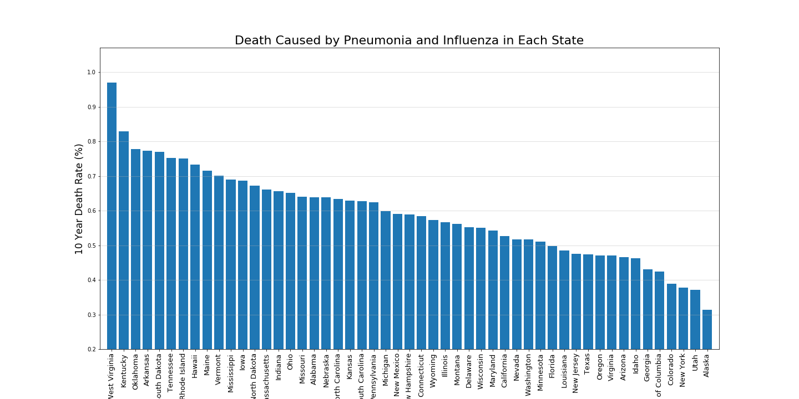
States with the Highest Death
Notes:
DANIEL
Highest Death State: West Virginia
Lowest Death State: Alaska
Deaths from pneumonia and influenza"] / ["Population]
Over 10 years

Slide 6
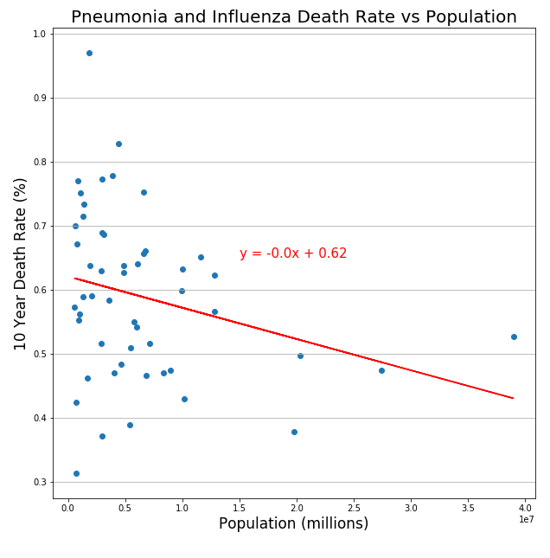
Death Rate and Population
Notes:
DANIEL

Slide 7
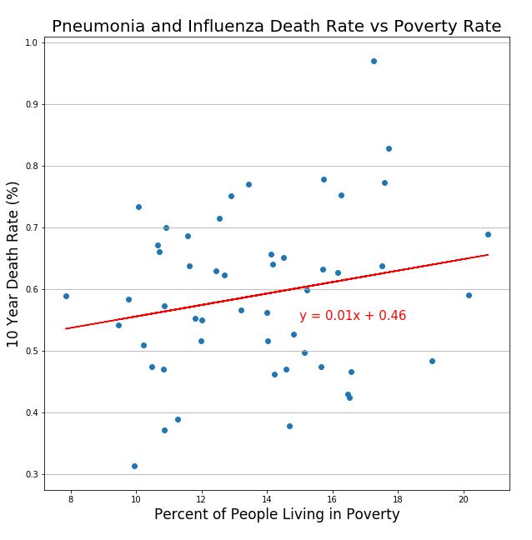
Death Rate and Poverty
Notes:
KOLAN

Slide 8
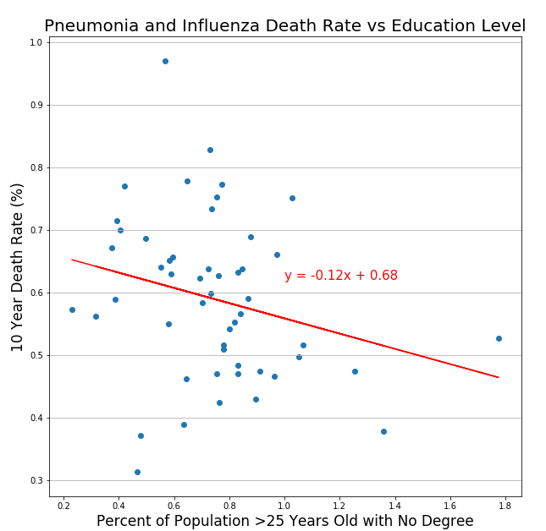
Death Rate and Education
Notes:
KOLAN

Slide 9
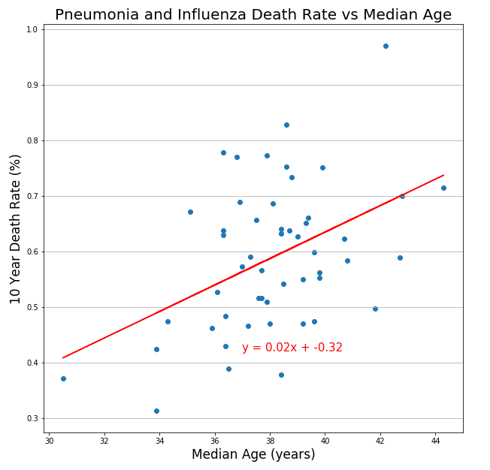
Death Rate and Age
Notes:
KOLAN

Slide 10
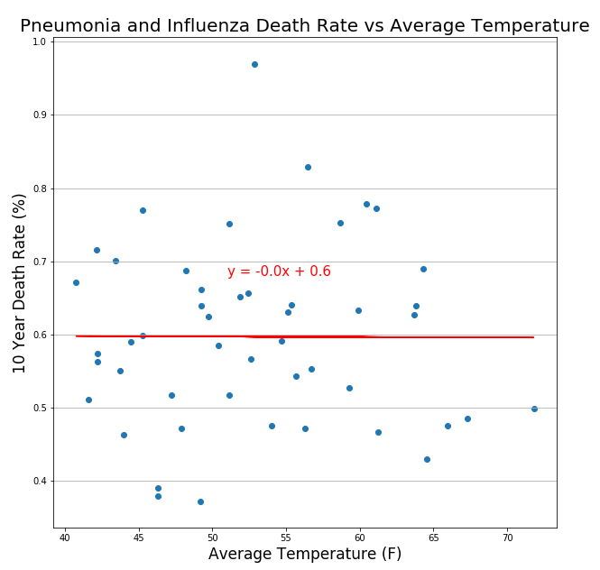
Death Rate and Temperature
Notes:
KOLAN

Slide 11
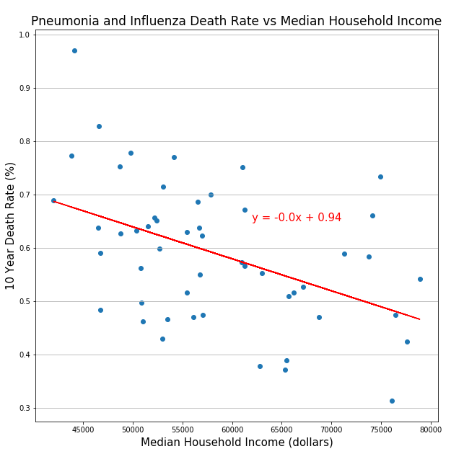
Death Rate and Income
Notes:
MONICA

Slide 12
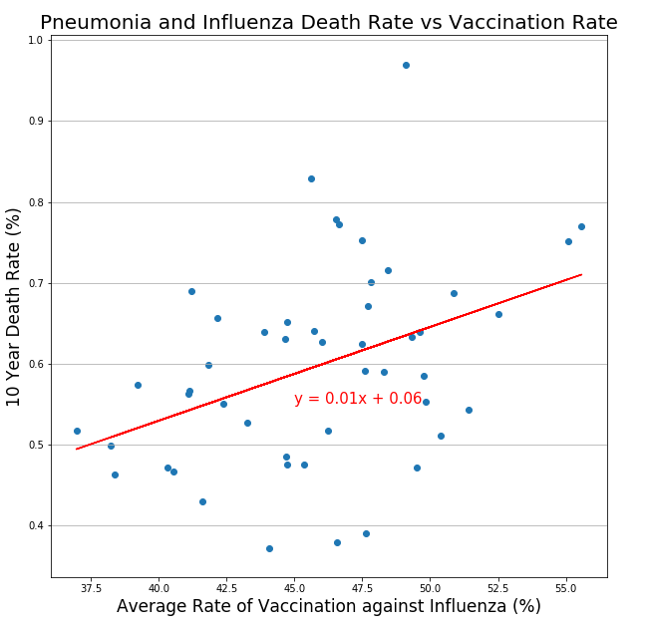
Death Rate and Vaccination
Notes:
Joey

Slide 13
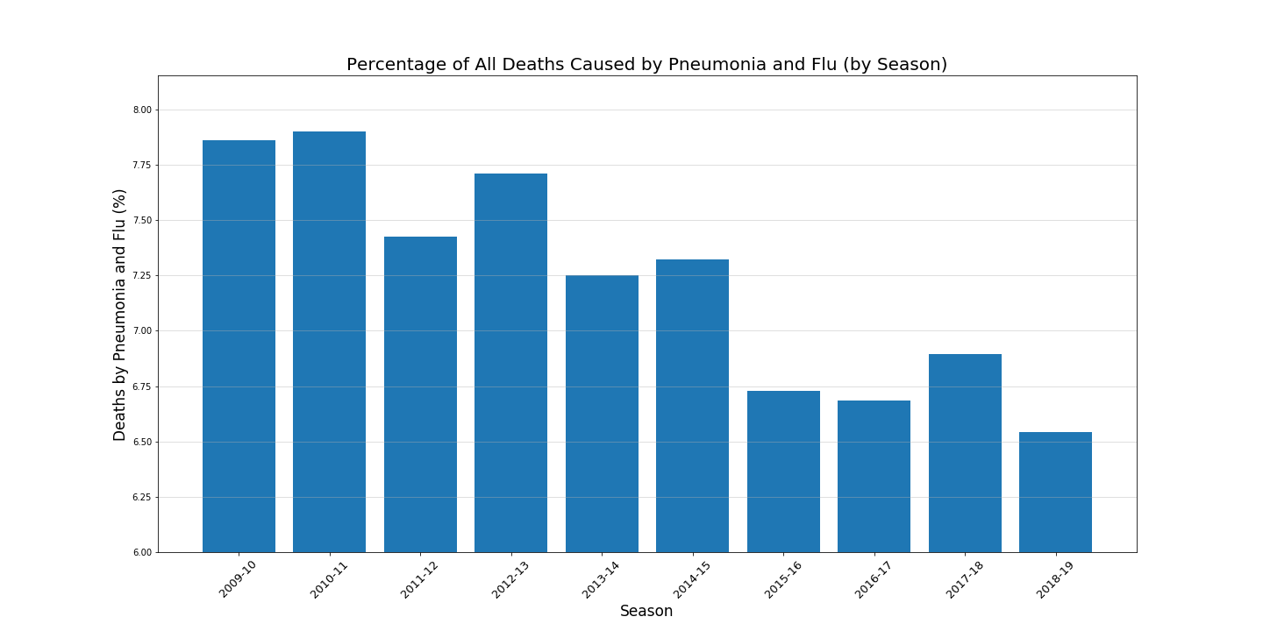
Seasons with the most deaths
Notes:
JOEY
Highest death season: 2010-11
Lowest death season: 2018-19
Overall trend: Death rate decreases

Slide 14
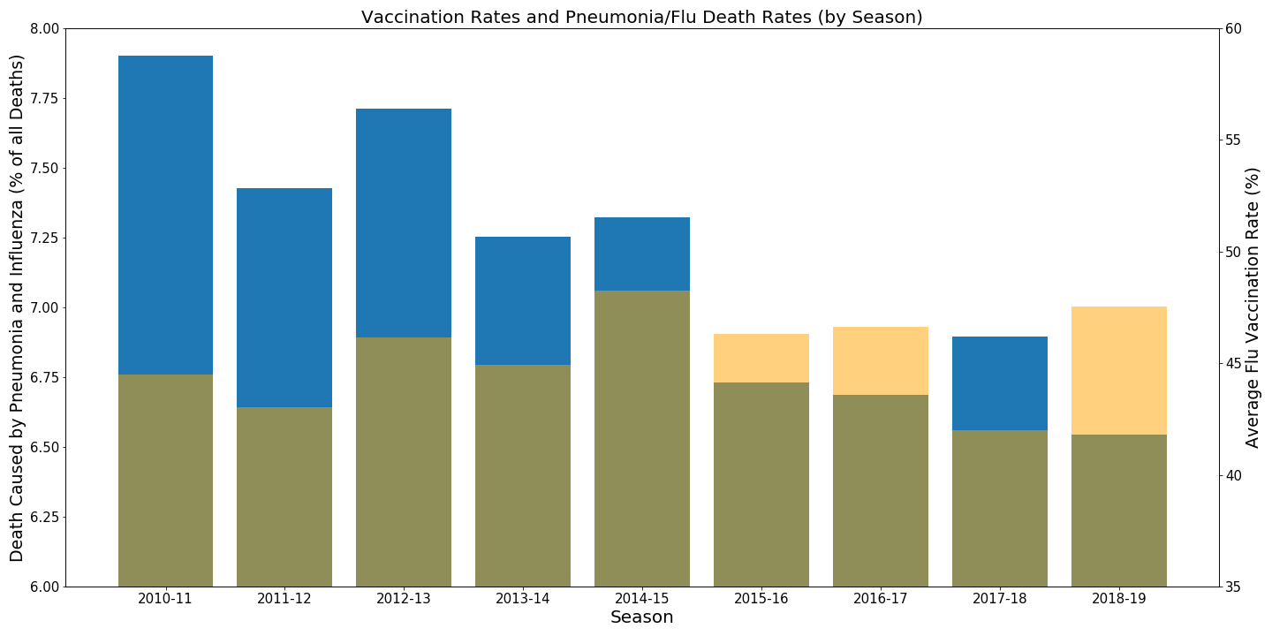
Vaccination and Seasons
Notes:
JOEY

Slide 15
Conclusion
Highest Death State: West Virginia
Highest Death Season: 2010-11
Correlations?:
Population
Temperature
Age
Income
Poverty
Vaccination
Multiple variables( i.e. pneumonia and influenza deaths)
Education
Notes:
Monica

Slide 16
Bloopers
Merging Errors
DataFrame errors
Graphing
Data source
Cleaning
Sample size (i.e. season)
Specific searches (by state)
Notes:
Joey
Graphing: trying to compare two bar charts together

Slide 17
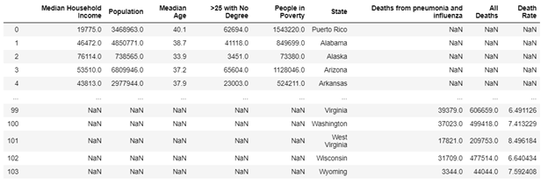
Blooper cont.
Notes:
Joey
Merging issues
Taking the census api and merging cdc file

